Slide 1
Yoga for a Positive Psychology
Psychology 1504
April 24, 2008
Debbie Cohen

Slide 2
Why yoga?
Emily story
Tool for well-being
Conviction from experience

Slide 3
Overview
Common Objective of Positive Psychology and Yoga
What is Yoga?
How Yoga works to cultivate a positive psychology
Yoga and Positive Psychology
Yoga for you

Slide 4


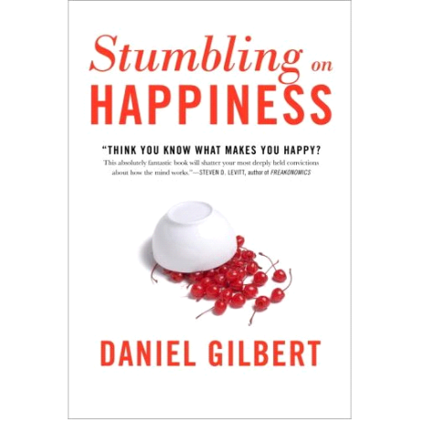

Happiness??

Slide 5
Happiness???
Common pursuit of Positive Psychology and of Yoga philosophy, teaching and practice

Slide 6
Optimal state of human functioning
???????
Aristotle- eudaimonia
Abraham Maslow- being cognition vs. deficit-motivated cognition
William James’ healthy-mindedness
Martin Seligman’s optimistic explanatory style
Mihalyi Csikszentimihalyi’s flow
Barbara Frederickson’s Broaden and Build theory

Slide 7
Optimal state of human functioning
???????
George Vaillant- mature defense mechanisms.
  Sublimation and altruism vs. suppression and projection
  “I don’t want you to think less of yourself. I want you to think of yourself less.”
  “As fly higher, air cools Daedalus’ wings”
(Positive Psychology conference, October, 2006)
Tal Ben-Shahar- Permission to be human
Daniel Gilbert- uselessness of stuck compass (Harvard Magazine, Jan/ Feb. 2007)

Slide 8
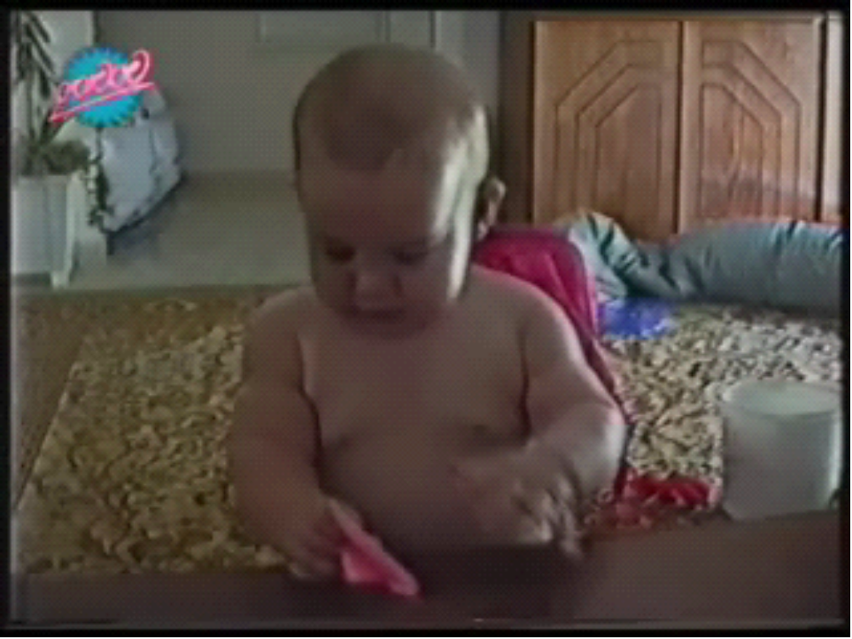

Slide 9
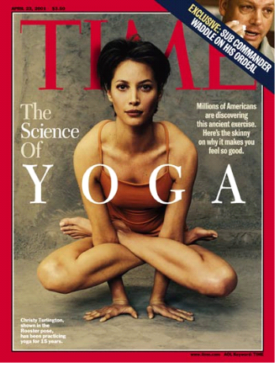
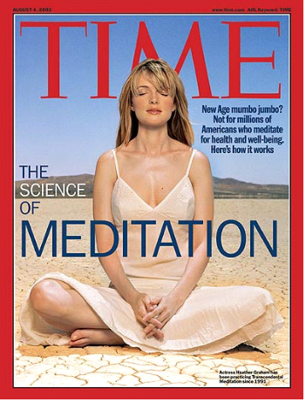

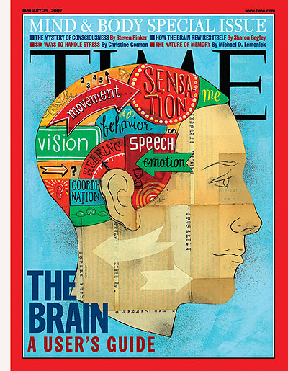
Current Fascination

Slide 10

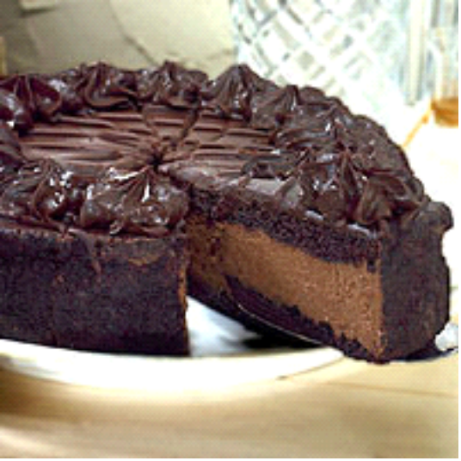
Yoga’s perspective on happiness

Slide 11
Yoga and Happiness
Street lamp story
Daniel Gilbert on affective forecasting bias (2002).

Slide 12

Yoga and Happiness
Taoist story of man and horse
“Everything is as it is and it’s all the same”
-Zayda Vallejo

Slide 13
Yoga for a Positive Psychology
The Mind
“I’ve had many catastrophes in my life, some of which actually happened”
-Mark Twain

Slide 14
Yoga, Nothing New
25,000 BCE Shamanism
3,000-1,900 BCE Indus-Sarasvati Civilization, North India
8th-12th c. Hatha Yoga- cultivating the body

Slide 15
What is Yoga?
Yoga Sutra 2nd or 3rd c. CE
YSI.2: Yogas citta vritti nirodhah: A technique to quiet the mind or “the restraint of the modification of the mind-stuff is yoga” (Satchidananda, 1999).
YS I.12: Abhyasa and Viragya: practice and equanimity

Slide 16
Yoga off the Mat and in context
Four Branches of Yoga
  Karma Yoga- action
  Bhakti Yoga- devotion
  Jnana Yoga- Self-study
  Raja Yoga- will-power
  Goal: Peace of Mind

Slide 17
Raja Yoga, the 8-limbed path
Yamas
Niyamas
Asana
Pranayama
Pratyahara
Dharana
Dhyana
Samadhi
Behavior- interactions
Behavior- individual
Posture
Breathing
Withdrawal of senses
Concentration
Effortless now
Complete absorption

Slide 18

Yoga for a Positive Psychology:
The Mind and Meditation
Brain changes
  Greater activation in left than right prefrontal cortex Richard Davidson, Jon Kabat-Zinn et al. (2003)
  New neural pathways (Krelman, Koch, & Fried, 2000).

Slide 19
More brain changes
Lazar 2005, 2006
  Resonance circuitry- Increased thickness in medial prefrontal cortex and insula, esp. right side
  Empathy, interoception and attunement to self and others
  Logical and intuitive processing.
Notes:
Insula- connects outer cortex to limbic brain- emotional. Maternal love and empathy

Slide 20
Hatha Yoga Research
Decreased vulnerability to stress in healthy exercising adults (Baldwin, 1999)
Mood
  113 psychiatric in-patients POMS (Lavey et al, 2005)
  Emotionally distressed women (Michaelson et al, 2005)
  Non-clinical subjects (Woolery, 2004)

Slide 21
Research on Hatha Yoga
Cardiovascular disease associated with insulin resistance in diabetes (Innes et al, 2005)
Sleep (Cohen, 2004, Khalsa, 2004)
Back pain (Sherman, 2005, Williams, 2005)- even 5 months later after 12 wk. program
Migraines (John, 2007)
Increased GABA levels - depression and anxiety down(Streeter et al, 2007)

Slide 22
Body and Mind
Stress Response
  Amygdala hijack (Reivich, 2002)
  Hypothalamus and stress response
    Tonus, blood pressure, blood sugar, heart rate, respiration
  Relaxation Response
    Anterior cingulate cortex and hippocampus
    Good decision-making, empathy, emotion, memory

Slide 23
Body and Mind
Candace Pert on Neuropeptides
Same neuropeptides are in the endocrine system, the limbic system, the gut
Example: Thirst
Notes:
peptides are ligands or molecules that bind to receptors on the suface of cells. They are made of strings of amino acids. Cell-engine, receptor on surface of cell is the control panel of that engine. Peptide is the finger that pushes the buttons on the control panel and gets things started.
Oxytocin from pituitary, insulin from panceas, vasoactive intestinal peptide from gut and gonadotrophin-releasing hormone from hypothalamus.
Same

Slide 24
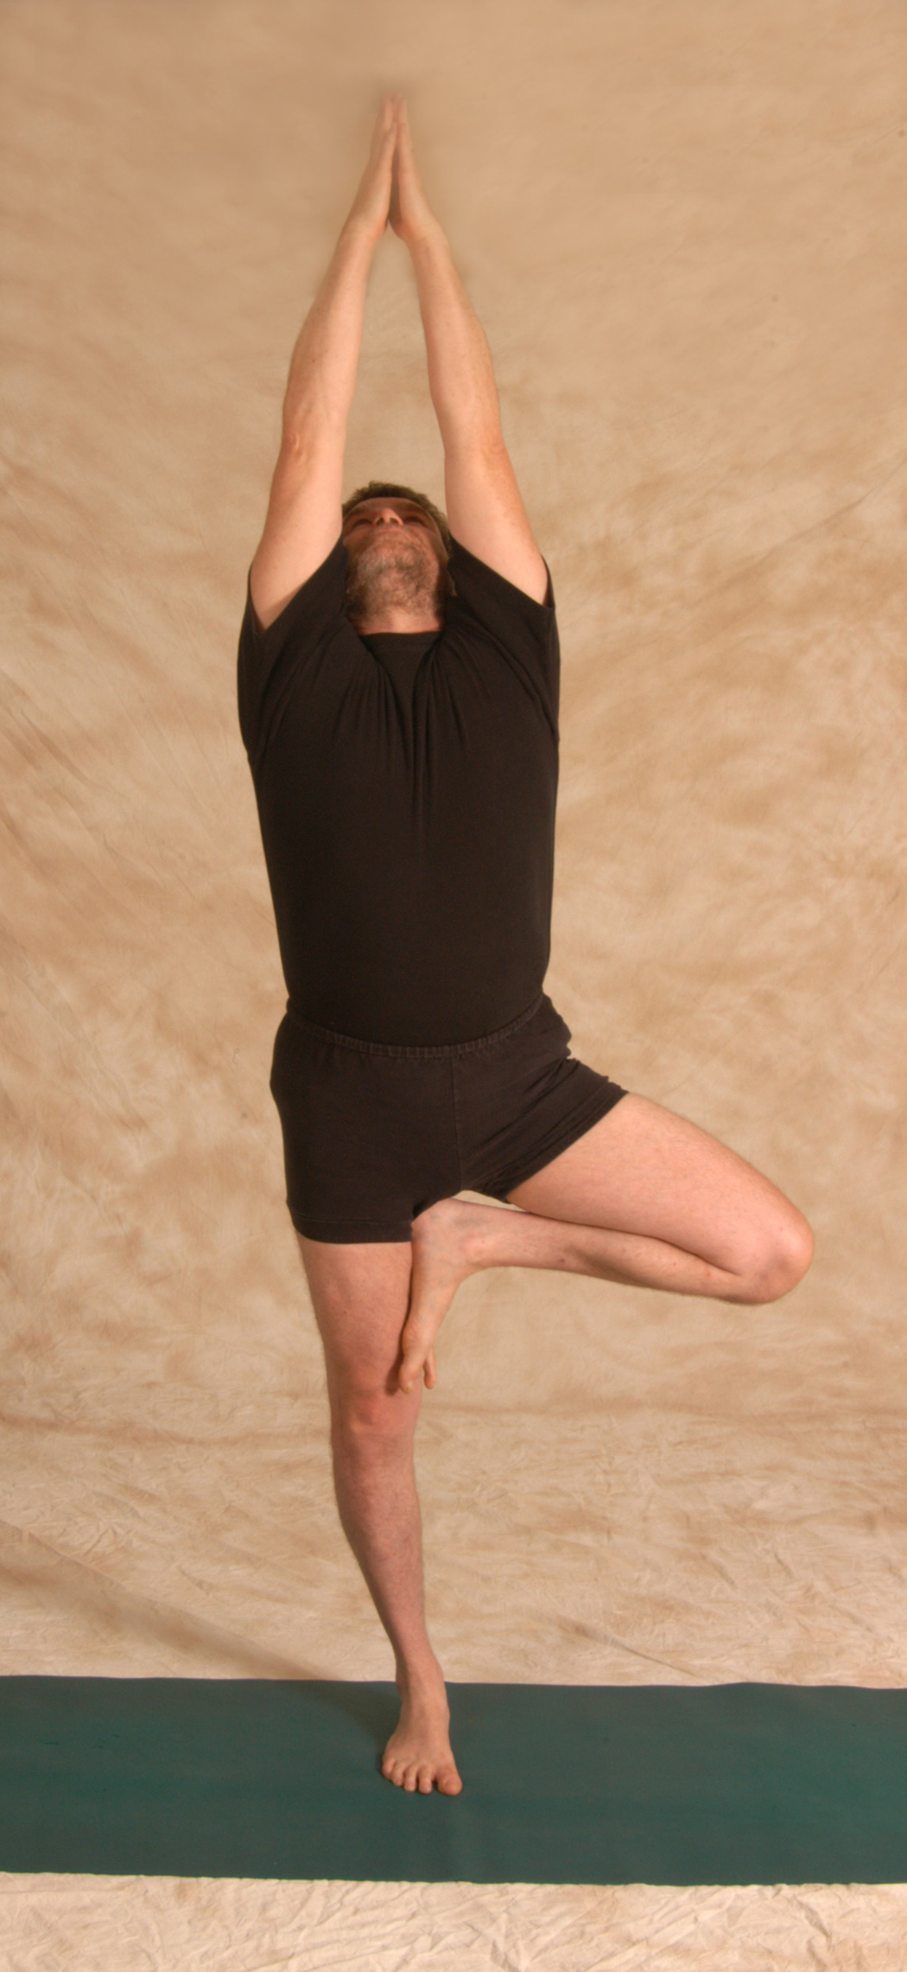
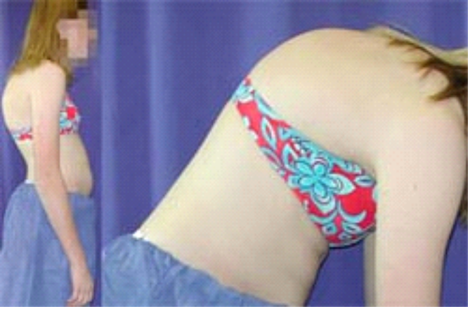
Yoga for a Positive Psychology
The Body, Hatha Yoga
De-conditioning
Re-patterning

Slide 25
Body affects emotions
Self-perception theory or facial feedback hypothesis (Laird, 1974; Strack, Martin, and Stepper, 1988; Sossignan, 2002; Schnall & Laird, 2003)
aka. What we do affects how we feel.

Slide 26
“Issues in our tissues” Patricia Walden
Body-based psychotherapies
  Pierre Janet (1859-1947)
Lowen’s Bioenergetics, Gestalt, I. Rolf’s Structural Integration, Feldenkrais
Yoga for Post-Traumatic Stress Disorder
  Bessel Van der Kolk

Slide 27
Acceptance? Re-pattern?
Kriya Yoga YS.II.1: an intense effort which is directed by the discriminative faculty, our intellect, to orient us towards clear seeing.
  Discipline- present moment awareness
  Self study
  Orientation towards clear seeing

Slide 28
Skillful means or perpetuating patterns?
Obsessional practice of a perfectionist perpetuating perfectionistic tendencies
Practicing acceptance when behavior is harming self and others.

Slide 29
Yoga for re-patterning
Practice must be one that pulls us out of self-centered patterns towards clarity.
Yoga- loss of ordinary sense of self to open to larger sense of Self

Slide 30
How to be happy
Aristotle- golden mean. No one action tendency always good
Arjuna in Bhagavad Gita
Path of maturity: self-referential to “hive emotions”

Slide 31
Necessity of context
“As Yoga practitioners and healers, do we prefer to tell students that backbends are effective in combating depression, rather than overcoming selfishness?” (Douglass, 2006).

Slide 32
Alignment
Ability to override habitual tendencies so have freedom to move as is appropriate in any given situation
  Practice on level of body
  Practice on level of mind
  Inform by Kriya yoga
  Mindfulness
  All for sake of peace of mind

Slide 33
Whose Domain is it Anyway?
Yoga for a Positive Psychology
  A positive intervention to “broaden and build” (Barbara Frederickson)
Positive Psychology for Yoga
  To provide context for an often de-contextualized practice
  Calm the mind to be able to be still

Slide 34
Positive Psychology and Yoga
A rose by another name?
Aristotle- eudaimonia and the golden mean
Abraham Maslow- being cognition vs. deficit-motivated cognition
William James’ healthy-mindedness
Martin Seligman’s optimistic explanatory style
Yamas and niyamas, part of raja yoga; kriya yoga
Meditative state where loss of ordinary sense of self
Niyama: sauca or contentment
Yoga as practice of recognizing and re-educating habitual patterns of thinking- meditation

Slide 35
Positive Psychology and Yoga
A wedding of east and west?
Mihalyi Csikszentimihalyi’s flow
Barbara Frederickson’s Broaden and Build theory and Marty Seligman’s learned optimism
Gratitude and trust
Bhagavad Gita: “He who recognizes the inaction that is in action, and the action that is in inaction is wise indeed…” (trans. Prabhavananda & Isherwood, 1995).
YSII.33 Neutralize unwholesome thoughts by cultivating wholesome thoughts.
YSI.12 Practice and equanimity

Slide 36
The Place of Paradox
1998 Martin Seligman, President of APA coins “Positive Psychology” and it is as old as humankind.
Non-judgmental acceptance of everything as it is AND technique to improve mind-state
  meditation
  hatha yoga

Slide 37
Wedding of two worlds
Embracing paradoxes
Deep respect for eastern historical and cultural context of yoga and use the practice to support us in more fully embracing our own lives here.

Slide 38
What is it to you?
Yoga- tool for peace of mind for you
  Regain balance, flexibility, strength, focus, relaxation
  Awareness of patterns, where stuck
  Start to become un-stuck
  Conviction with experience

Slide 39
What kind of yoga?
Meet yourself where you are and then start to move in skillful direction.
Sedentary? Start with gentle yoga and gradually work towards more challenging poses.
Obsessive exerciser? Start with dynamic style and gradually move towards a more meditative practice.

Slide 40
What style of yoga?
Gentle yoga
  Hatha
  Kripalu
  Svaroopa
  Viniyoga
  Integral
Spiritual
  Kundalini
Medium
  Iyengar
  Anusara
  Sivananda
Dynamic
  Ashtanga (usu. hot)
  Bikram (hot)
  Power yoga (hot)
  Vinyasa (“flow”)

Slide 41
How to find a teacher near you
Listings of teachers
www.yogajournal.com
www.yogaalliance.org

Slide 42
Finding a good yoga teacher
Reputation/ word of mouth
Shop around
A good match
Elicits mindfulness and relaxation
Understands how the body works and understands the poses
Committed to the practice
Communicates effectively

Slide 43
References
Aristotle. (1985). Nicomachean ethics. (Irwin, Terence, Trans.). Indianapolis, IN: Hackett Publishing Co.
Baldwin, Maria. Psychological and physiological influences of hatha yoga training on healthy, exercising adults. Dissertation Abstracts International Section A:Humanities and Social Science, 60 (4-A), 1031.
Ben-Shahar, Tal. (2002). The question of happiness: On finding meaning, pleasure, and the ultimate currency. Lincoln, NE: Writer’s Club Press.
Bennett-Goleman, Tara. (2001). Emotional alchemy: How the mind can heal the heart. New York: Random House, Inc.

Slide 44
References
Cohen, L, Warneke, C., Fouladi, RT, Rodriguez, MA, Chaoul-Reich, A. (2004). Psychological adjustment and sleep quality in a randomized trial of the effects of a Tibetan yoga intervention in patients with lymphoma. Cancer 100 (10): 2253-2260.
Czikszentmihalyi, Mihaly. (1997). Finding flow: The psychology of engagement with everyday life. New York: Harper-Collins.
Davidson, Richard J., Kabat-Zinn, Jon et al. (2003). Alterations in brain and immune function produced by mindfulness meditation. Psychosomatic Medicine, 65, 564-570.
Desikachar, T.K.V. (2007). Positively Healing. Yoga Journal, 201, 111-115.

Slide 45
References
Douglass, L. (2006). Integrating yoga cikitsa in the west: Challenges and future directions. International journal of yoga therapy, 16, 21-32.
Duclos, Sandra, Laird, James, Schneider, Eric, & Sexter, Melissa, et al. (1989). Emotion-specific effects of facial expressions and postures on emotional experience. Journal of Personality and social psychology, 57 (1) 100-108.
Duclos, Sandra, & Laird, James. (2001). The deliberate control of emotional experience through control of expressions. Cognition & emotion, 15 (1), 27-56.
Feuerstein, Georg, Bodian, Stephen. (1993). Living yoga: A comprehensive guide for daily life. New York: Penguin Putnam.

Slide 46
References
Gilbert, Daniel T., Pinel, Elizabeth C., Wilson, Timothy D., Blumberg, Stephen J., & Wheatley, Thalia P. (2002). Durability bias in affective forecasting. In Gilovich, Thomas, Griffin, Dale, Kahneman, Daniel (Eds.), Heuristics and biases: The psychology of intuitive judgment. (pp. 292-312). New York, NY: Cambridge University Press.
Haidt, Johnathan. (2006). The happiness hypothesis: Finding modern truth in ancient wisdom. New York: Basic Books.
Innes, K.E. et al. (2005). Risk indices associated with the insulin resistance syndrome, cardiovascular disease, and possible protection with yoga: a systematic review. Journal of the American Board of Family Practice, 18 (6), 491-519.
James, William. Selections from Talks to Teachers (1897).
James, William. Selections from Principles of Psychology: Briefer Course (1892).

Slide 47
References
John, P.J. et al. (2007). Effectiveness of yoga therapy in the treatment of migraine without aura: A randomized controlled trial. Headache, 47 (5), 654-661.Kabat-Zinn, J. (1996) Full catastrophe living. New York: Delacorte Press.
Kabat-Zinn, J. (1996) Full catastrophe living. New York: Delacorte Press.
Kabat-Zinn, Jon, Lipworth, Leslie, Burney, Robert. The clinical use of mindfulness meditation for the self-regulation of chronic pain. Journal of behavioral medicine, 8 (2), 163-190.
Kabat-Zinn, Jon, Massion, Ann, Kristeller, Jean, Peterson, Linda, et al. Effectiveness of a meditation-based stress reduction program in the treatment of anxiety disorders. American journal of psychiatry, 149 (7), 936-943.

Slide 48
References
Khalsa, S.B. (2004). Treatment of chronic insomnia with yoga: A preliminary study with sleep-wake diaries. Applied Psychophysiology and Biofeedback, Dec. 29, 4, 269-279.
Laird, James D., & Bresler, Charles. (1992). The process of emotional experience: A self-perception theory. In Clark, Margaret S. (Ed). Review of personality and social psychology, 13 (pp. 213-234). Thousand Oaks, CA, US: Sage Publications, Inc.
Laird, James D., & Schnall, Simone. (2003). Keep smiling: Enduring effects of facial expressions and postures on emotional experience and memory. Cognition & emotion, 17 (5), 787-797.
Lambert, Craig. (2007). The science of happiness. Harvard magazine 109 (3), 26-30, 94-95.

Slide 49
References
Lavey, Roberta, Sherman, Tom, Mueser, Kim, Osborne, Donna, Currier, Melinda, Wolfe, Rosemarie (2005). The effects of yoga on mood in psychiatric inpatients. Psychiatric Rehabilitation Journal, 28 (4), 399-402.
Lazar, S. (2006) Mind-body connection: Neural correlates of respiration during meditation. Presented at Mind and Life Summer Research Institute, Garrison, New York.
Lazar, S.W., Kerr, C.E., Wasserman, R.H., Gray, J.R., Greve, D.N., Treadway, M.T. et al. (2005). Meditation experience is associated with increased cortical thickness. Neuroreport, 16 (17), 1893-1897.

Slide 50
References
Lowen, Alexander. (1958). The language of the body. New York, NY: Macmillan Publishing Co., Inc.
Martin, Leonard, Stepper, Sabine, & Strack, Fritz. (1988). Inhibiting and facilitating conditions of the human smile: A nonobtrusive test of the facial feedback hypothesis. Journal of personality and social psychology, 54 (5), 768-777.
Maslow, Abraham H. (1968/ 1999). Selected chapters from Towards a psychology of being, 3rd Edition. New York: John Wiley & Sons.
Michaelson, A. et al. (2005). Rapid stress reduction and anxiolysis among distressed women as a consequence of a three-month intensive yoga program. Medical Science Monitor, 11 (12), 555-561.

Slide 51
References
Patanjali. (2003). The yoga sutra of patanjali. (Chip Hartranft, Trans.). Boston, Massachusetts: Shambhala Publications, Inc. (Original work unpublished)
Patanjali. (1978/ 1999). The yoga sutras of patanjali. (Sri Swami Satchidananda, Trans.).Virginia: Integral Yoga Publications. (Original work unpublished).
Pawelski, J. (2003). William James, positive psychology, and healthy-mindedness. The Journal of Speculative Philosophy (New Series) 17, 53-67.

Slide 52
References
Peterson, Christopher & Seligman, Martin. (2004). Character strengths and virtues: A handbook and classification. New York, NY: Oxford University Press.
Peterson, Christopher. (2006). A Primer in Positive Psychology. New York, NY: Oxford University Press, Inc.
Reivich, Karen, Shatte, Andrew.(2002). The resilience factor: Seven keys to finding your inner strength and overcoming life’s hurdles. Broadway Books.

Slide 53
References
Salovey, P., Caruso, D., & Mayer, J.D. (2004). Emotional intelligence in practice. In Linley, P.A. & Joseph, S. (Eds), Positive psychology in practice (pp. 4477-463). Hoboken, NJ: Wiley.
Seligman, Martin. (2002). Authentic happiness. New York, NY: Free Press, Simon & Schuster, Inc.
Shapiro, Shauna L., Schwartz, Gary E.R., & Santerre, Craig. (2005).Meditation and positive psychology. In Snyder, C.R., & Lopez, Shane J. (Eds.), Handbook of positive psychology (pp. 146-164). New York, NY: Oxford University Press.
Sherman, K.J, Cherkin, D.C., Eroo, J., Miglioretti D.L., Deyo, R.A. (2005). Ann Intern Med. 143 (12): 849-856.

Slide 54
References
Smith, W.P., Compton, W.C., & West, W.B. (1995). Meditation as an adjunct to a
happiness enhancement program. Journal of clinical psychology, 51, 269-273.
Soussignan, Robert.(2002). Duchenne smile, emotional experience, and autonomic reactivity: A test of the facial feedback hypothesis. Emotion, Vol 2(1), Mar 2002, 52-74.
Strack, Fritz, Martin, Leonard L., Stepper, Sabine. (1988). Inhibiting and facilitating onditions of the human smile: A nonobtrusive test of the facial feedback hypothesis. Journal of Personality and Social Psychology, 54(5), May 1988, 768-777.
Streeter, CC., Jesens, JE, Perimutter, R.M., Cabral, H.J., Tian, H., Terhune, D.B., Ciraulo, D.A., Renshaw, P.F. (2007). Yoga asana sessions increase brain GABA levels: A pilot study. Journal of Alternative and Complementary Medicine, 13 (4) 419-426.

Slide 55
References
Van der Kolk, B, Pelcovitz, D., Roth, S., Mandel, F., McFarlane, A. & Herman, J. (1996). Dissociation, affect dysregulation and somatization: The complex nature of adaptation to trauma. Trauma Information Pages. Retrieved November 4, 2006 from http://www.traumacenter.org.
Vaillant, George. (1977). Adaptation to life. Boston, MA: Little, Brown.
Williams, K.A., Petronis, J., Smith, D., Goodrich, D., Wu, J., Ravi et al. (2005). Effect of Iyengar yoga therapy for chronic low back pain. Pain 115 (1-2): 107-117. Unknown original author. (1995). Bhagavad-gita. (Swami Prabhavananda& Christopher Isherwood, Trans.). New York: Barnes & Noble Books. (Original work unpublished)
Unknown original author. (1985). The Bhagavad gita. (Eknath Easwaran, Trans.). Berkeley, California: Blue Mountain Center of Meditation.

